Slide 1

The Photoelectric Effect
When Light Behaves as Particles
Exploring the quantum phenomenon that revolutionized physics and earned Einstein the Nobel Prize

Slide 2

What is the Photoelectric Effect?
The photoelectric effect occurs when light shines on a metal surface and ejects electrons from it. This seemingly simple phenomenon puzzled scientists for years because it couldn't be explained by classical wave theory.
When photons strike metal atoms, they transfer their energy to electrons. If this energy exceeds the metal's work function, electrons escape the surface. This discovery fundamentally changed our understanding of light's nature.
The Key Question
Why did classical physics completely fail to explain these observations?

Slide 3

Key Experimental Observations
Scientists discovered four surprising behaviors that contradicted classical wave theory:
Immediate Emission
Threshold Frequency
Electrons are ejected instantly when light hits the surface—no time delay, even with dim light
Light must exceed a minimum frequency to eject electrons, regardless of intensity
Energy Depends on Frequency
Rate Depends on Intensity
Electron kinetic energy increases with light frequency, not brightness
Brighter light ejects more electrons per second but doesn't change their energy

Slide 4

Classical Theory vs. Reality
Classical wave theory made predictions that were completely contradicted by experimental results:
Classical Prediction
Actual Result
Delayed emission (energy accumulates gradually)
Immediate emission (instantaneous)
Electron energy depends on light intensity
Electron energy depends on frequency
Any frequency should work with enough time
Minimum threshold frequency required
Brighter light = more energetic electrons
Brighter light = more electrons, same energy
The Crisis: Classical wave theory couldn't explain these observations. Physics needed a revolutionary new approach to understand light's behavior at the atomic scale.

Slide 5

Einstein's Revolutionary Solution
The Photon Theory (1905)
Photon Energy Formula
Einstein proposed that light consists of discrete energy packets called photons. Each photon carries a specific amount of energy determined by its frequency.
E = hν
Where h is Planck's constant and ν (nu) is the light's frequency
The Photoelectric Equation
Kmax = hν - φ
Maximum kinetic energy equals photon energy minus work function
This groundbreaking work earned Einstein the 1921 Nobel Prize in Physics

Slide 6
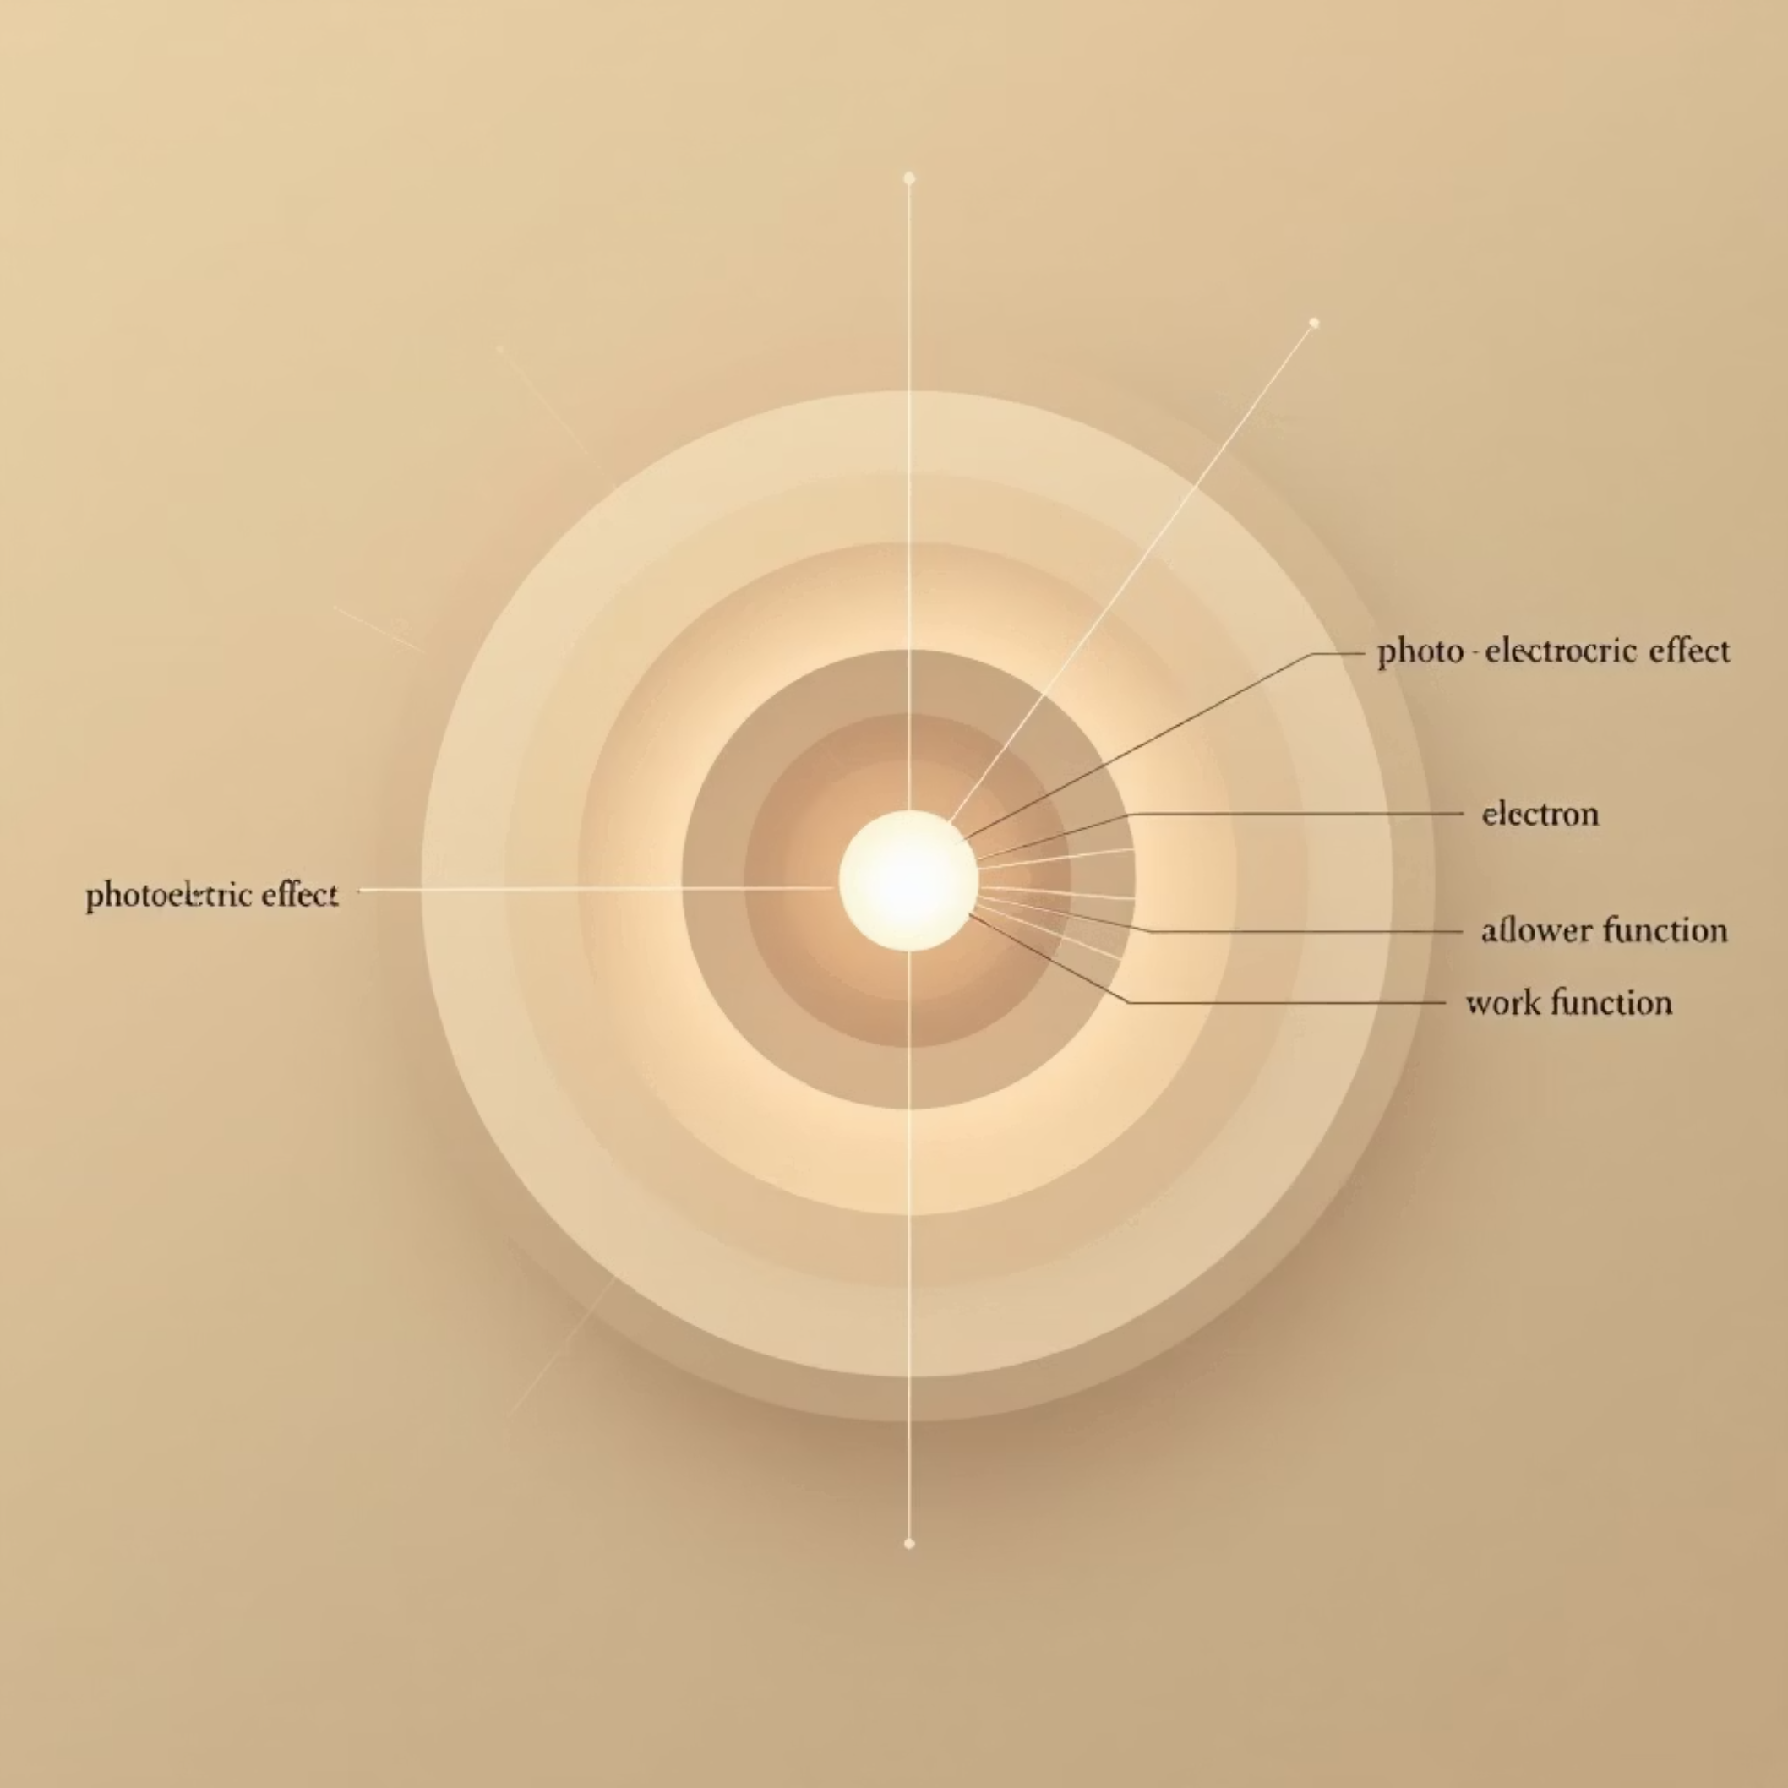
Understanding the Photoelectric Equation
Kmax = hν - φ
Kmax = Maximum kinetic energy of ejected electrons
h = Planck's constant(6.63 × 10-34 J·s)
ν = Frequency of incident light
φ = Work function (energy needed to free an electron from the metal)
When a photon strikes the metal surface, it transfers all its energy to a single electron. If this energy exceeds the work function, the electron escapes with leftover energy as kinetic energy.

Slide 7

Visualizing the Relationship
Plotting maximum kinetic energy against light frequency reveals the linear relationship predicted by Einstein's equation:
Slope = h
X-intercept = ν₀
The graph's slope equals Planck's constant, a fundamental value in quantum mechanics
Where the line crosses the x-axis gives the threshold frequency for that metal
Different Metals
Each metal has a unique work function, creating parallel lines with different intercepts

Slide 8
Work Functions of Common Metals
Different metals require different amounts of energy to liberate their electrons. The work function determines the threshold frequency for each material:
2.28
4.3
6.35
Sodium (eV)
Zinc (eV)
Platinum (eV)
Lowest work function—responds to visible light, making it ideal for photoelectric applications
Moderate work function—requires ultraviolet light for electron emission
Highest work function—needs high-energy UV photons to eject electrons
Key Insight: Higher work function means the metal holds its electrons more tightly, requiring higher frequency (more energetic) photons to liberate them.

Slide 9
Real-World Applications
The photoelectric effect isn't just theoretical—it powers countless modern technologies we use every day:
Solar Panels
Automatic Sensors
Digital Imaging
Security Systems
Convert sunlight directly into electricity using photovoltaic cells based on the photoelectric effect
Photocells detect light changes to trigger automatic doors, street lights, and security systems
Camera sensors use photoelectric principles to capture images and convert light into electrical signals
Beam detectors and burglar alarms use photoelectric sensors to detect interruptions in light beams

Slide 10




The Legacy of the Photoelectric Effect
Revolutionary Discovery
Proved light has particle properties, fundamentally changing physics
Birth of Quantum Mechanics
Laid the foundation for quantum theory and modern physics
Practical Impact
Enabled the optoelectronics revolution that powers today's technology
Wave-Particle Duality
The photoelectric effect revealed that light exhibits both wave and particle characteristics—a profound insight that continues to shape our understanding of the quantum world.

